Slide 1
Systems Analysis and Design CT026-3-1
System Analyst and Project Manager

Slide 2
Topic & Structure of The Lesson
Roles and Skills of a System Analysts and Project Manager
Project Management Issues

Slide 3
Learning Outcomes
By the end of this module, YOU should be able to:
Roles and Skills of a Systems Analyst
Roles and Skills of a Project Manager
Resistance to change

Slide 4
Key terms you must be able to use
If you have mastered this topic, you should be able to use the following terms correctly in your assignments and exams:
System Analyst
Project Manager
Project Management

Slide 5
Roles of a Systems Analyst
According to Hoffer:
Consultant
A systems consultant to a business
Hired specifically to address information systems issues within a business
Supporting Expert
Draws on professional expertise concerning computer hardware and software and their uses in the business
Not managing the project but merely serving as a resource for those who are

Slide 6
Roles of a Systems Analyst
Agent of change
A comprehensive and responsible role whether internal or external to the business
A person who serves as a catalyst for change, develops a plan for change, and works with others in facilitating change

Slide 7
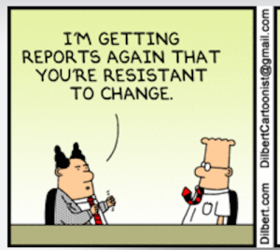
Resistance to Change
Why are people afraid of change?

Slide 8
Resistance to change
Reasons
The threat to job security
The reduction in social satisfaction
The reduction of self-esteem and reputation

Slide 9
Resistance to change
Effects
withholding facts
providing inaccurate data
displaying an attitude of indifference

Slide 10
Resistance to change
Methods to overcome
Keep people informed about
effects of the change on their job
reason for (and the benefits of) the changes
Transfer employee to other dept so that the employee is employed
Extend necessary retraining
Seek Employee Participation

Slide 11
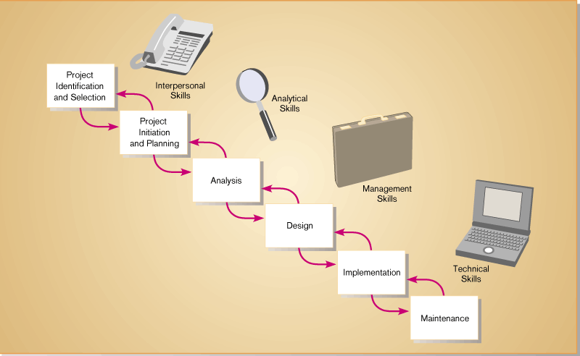
Skills of a Systems Analyst
Figure 2.1 – The relationship between a systems analyst’s skills and the systems development lifecycle
Modern Systems Analysis and Design, 3/e - Jeffrey A. Hoffer Joey F. George Joseph S. Valacich

Slide 12
Skills of a Systems Analyst
According to Hoffer:
Analytical Skills
Systems thinking
Organization knowledge
Problem identification
Problem analysis & solution

Slide 13
Skills of a Systems Analyst
Management Skills
Resource Management
Change Management
Risk Management
Project Management

Slide 14
Skills of a Systems Analyst
Technical Skills
Constant re-education
Keep skills up-to-date
Understanding a wide variety of technologies

Slide 15
Skills of a Systems Analyst
Interpersonal Skills
Communication Skills
Working alone / working with a team
Managing expectations of users / managers
Facilitating Groups

Slide 16
Project Management
What Shapes a Project?
Successful projects must be completed on time, within budget, meet requirements, and satisfy users

Slide 17
Roles and Skills of a Project Manager
What Does a Project Manager Do?
Good manager; leadership is essential
Project planning
Project scheduling
Project monitoring and controlling
Project reporting

Slide 18
Roles and Skills of a Project Manager
Project Planning
Identify all project tasks and estimate the completion time and cost of each

Slide 19
Roles and Skills of a Project Manager
Project scheduling
Create a specific timetable that shows tasks, task dependencies, and critical tasks that might delay the project.
Manager must know :
the duration of each activity
the order in which the activities will be performed / determined whether certain task depend on other activities
the start and end times of each activity - an activity cannot start until preceding activity/task is completed
who will be assigned to each specific task- workload should not overload/under-utilize team members.

Slide 20
Roles and Skills of a Project Manager
Project monitoring and controlling
Guiding, supervising, and coordinating the project team’s workload
To help ensure that quality standards are met
Structured walkthrough : a review of a project team members’ work by other members of the team

Slide 21
Roles and Skills of a Project Manager
Project reporting
Create regular progress reports to management, users, and the project team itself
Conduct Project Status Meetings: Schedule regular meetings to update the team and discuss project status, issues, problems, and opportunities
Project Status Reports: A progress report to management and user usually are written
Gantt charts are often included to show project status graphically

Slide 22
Project Management Issues
Business Issues
The major objective of every system is to provide a solution to a business problem or opportunity
A system that falls short of business needs also produces problems for users and reduces employee morale and productivity
Project creep

Slide 23
Project Management Issues
Budget Issues
Cost overruns typically result from one or more of the following:
Unrealistic estimates
Failure to develop an accurate forecast that considers all costs over the life of the project
Poor monitoring of progress and slow response to early warning signs of problems

Slide 24
Project Management Issues
Budget Issues
Cost overruns typically result from one or more of the following:
Schedule delays due to factors that were not foreseen
Human resource issues, including turnover, inadequate training, and motivation

Slide 25
Project Management Issues
Schedule Issues
Problems with timetables and project milestones can indicate a failure to recognize task dependencies, confusion between effort and progress, poor monitoring and control methods, personality conflicts among team members, or turnover of project personnel

Slide 26
The Bottom Line
When problems occur, the project manager’s ability to handle the situation becomes the critical factor
Sometimes, when a project experiences delays or cost overruns, the system still can be delivered on time and within budget if several less critical requirements are trimmed
Brooks’ Law:- is a claim about software project management according to which “adding manpower to a late software project makes it later”

Slide 27
Quick Review Question
List the main roles of system analyst?
List the mail roles of project manager?

Slide 28
Summary of Main Teaching Points
Every successful information system must support business requirements, stay within budget, and be available on time
Sound project management involves the same skills as any other management

Slide 29
Question and Answer Session
Q & A

Slide 30
What we will cover next
Systems Development Life Cycle (SDLC)
Overview of SDLC
Phases in SDLC

Slide 31
References
Essential Reading
Satzinger,J.W., Jackson,R.B., Burd,S.D. (2016). Systems Analysis and Design in a Changing World. 7th ed. Cengage Learning. ISBN: 1305117204 • Valacich,J.A., George,J. (2016). Modern Systems Analysis and Design. 8th ed. Pearson. ISBN: 0134204921
Suggested Reading
Schwalbe,K. (2016). Information technology project management. 8th ed. Course Technology. ISBN: 9781285452340

